Slide 1
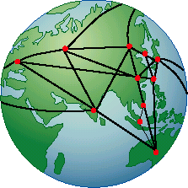
Computer Networks

Slide 2

Computer Networks
Lin Weiguo Prof.
School of Computer Science & Cybersecurity
Copyleft © 2003~2020
linwei@cuc.edu.cn
http://tlc.cuc.edu.cn
Notes:
Computer networks are nearly ubiquitous today. And, new applications extending their use are being developed daily. They are essential to numerous distributed systems and exciting applications.
This course will provide a modern introduction to the dynamic field of computer networks. It will provide fundamental understanding as well as insights to understanding today's networks and those of the future. In this course, we will use the public Internet as our main example for discussing computer networks and their protocols.

Slide 3
Roadmap
Introduction
Physical Layer
Data Link Layer
Medium Access Sublayer
Network Layer
Transport Layer
Application Layer
Notes:
Every one should present himself

Slide 4
The Physical Layer
Chapter 2

Slide 5
What You Will Learn
Theoretical Basis For Data Transmission
How much data can be put on a wire? What are the limits imposed by a medium?
Guided transmission media
Wireless Transmission. (terrestrial radio)
Communication Satellites.
Digital modulation and Multiplexing
Examples of communication systems
the (fixed) telephone system/ xDSL
the mobile phone system
the cable television system. / CableModem

Slide 6
2.1 Theoretical Basis for Data Communication
Fourier Analysis
Bandwidth-Limited Signals
Maximum Data Rate of a Channel

Slide 7
Fourier Analysis
Information can be transmitted on wires by varying some physical property such as voltage or current.
By representing the value of this voltage or current as a single-valued function of time, f(t), we can model the behavior of the signal and analyze it mathematically.
Notes:
Fourier ['furiei]
法国数学家、物理学家傅立叶，1768年3月21日生于欧塞尔，1830年5月16日卒于巴黎。

Slide 8
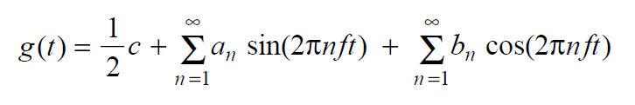
Fourier Series
Fourier Series - Any reasonably behaved periodic function, g(t) with period T, can be constructed as the sum of (possibly infinite) number of sines and cosines:
where f = 1/T is the fundamental frequency, a_{n} and b_{n} are the sine and cosine amplitudes of the n^{th} harmonics (terms), and c is a constant.
Notes:
sinusoidal
[ˌsainəˈsɔidl]
adj.

Slide 9
Harmonics
If the period T is known and the amplitudes are given, the original function of time can be found by performing the sums of Fourier Equation.
Signals of any flavor are made up of harmonics. One could in theory have a pure sine wave, but that's pretty dull - it carries no real information other than its frequency (musically it's pretty dull too.)
In practice, information-carrying-signals are made up of a number of frequencies. These typically are the fundamental frequency, plus other frequencies that are multiples of the fundamental. These higher frequency components are called harmonics.

Slide 10
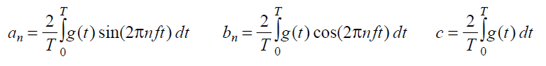
Fourier Equation
A data signal that has a finite duration can be handled by just imagining that it repeats the entire pattern over and over forever.
The A_{n} and B_{n} amplitudes and C can be computed for any given g(t):
Notes:
The coefficients A_{n} and B_{n} are determined for each component - they represent the amplitude of the individual waves.
The a_{n} amplitudes can be computed for any given g(t) by multiplying both sides of Eq. (2-1) by sin(2pkft) and then integrating from 0 to T.
Differential and integral calculus.
derivatives

Slide 11
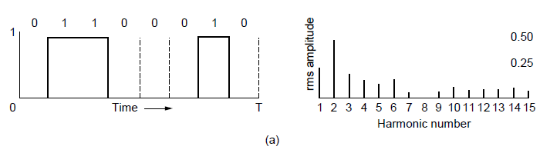
A signal in a real channel
The relevance of Fourier Analysis to data communication is that channels affect different frequency signals differently.
A binary signal and its root-mean-square Fourier amplitudes.
Notes:
Let’s consider a specific example: the transmission of the ASCII character “b” encoded in an 8-bit byte. The bit pattern that is to be transmitted is 01100010.
The left-hand shows the voltage output by the transmitting computer.
The Fourier analysis of this signal yields the coefficients: an, bn, c
No transmission facility can transmit signals without losing some power in the process. If all the Fourier components were equally diminished, the resulting signal would be reduced in amplitude but not distorted.[i.e., it would have the same nice squared-off shape as Fig.2-1a]. Unfortunately, all transmission facilities diminish different Fourier components by different amounts, thus introducing distortion.

Slide 12
rms
The root-mean-square amplitudes,
,
which are displayed on the right-hand of figure, are of interest because their squares are proportional to the energy transmitted at the corresponding frequency.

Slide 13
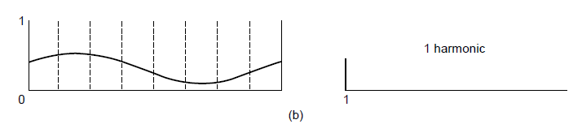
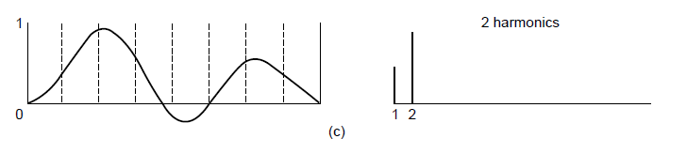
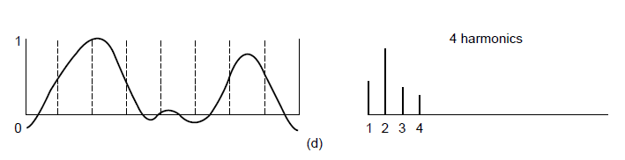
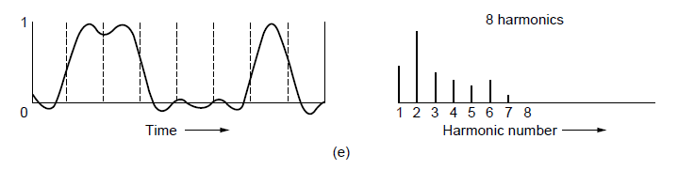
Bandwidth-Limited Signals
(b) – (c) Successive approximations to the original signal.
Notes:
Now let us consider how the signal of Fig.2-1 (a) would look if the bandwidth were so low that only the lowest frequencies were transmitted[i.e. If the function were being approximated by the first few terms of Eq 2-1].
Fig b shows the signal that results from a channel that allows only the first harmonic, the fundamental f.
Similarly, fig c-e show the spectra and reconstructed functions for higher-bandwidth channels.
For digital transmission, the goal is to receive a signal with just enough fidelity to reconstruct the sequence of bits that was sent.
We can already do this easily in Fig e, so it is wasteful to use more harmonics to receive a more accurate replica.

Slide 14
Bandwidth
All transmission facilities diminish different Fourier components by different amounts, thus introducing distortion.
Usually, for a wire, the amplitudes are transmitted undiminished from 0 up to some frequency f_{c} [measured in cycles/sec or Hertz (Hz)] with all frequencies above this cutoff frequency attenuated.
The range of frequencies transmitted without being strongly attenuated is called the bandwidth.
Notes:
No transmission facility can transmit signals without losing some power in the process. If all the Fourier components were equally diminished, the resulting signal would be reduced in amplitude but not distorted [i.e., it would have the same nice squared-off shape as Fig. 2-1(a)]. Unfortunately, all transmission facilities diminish different Fourier components by different amounts, thus introducing distortion.
In practice, the cutoff is not really sharp, so often the quoted bandwidth is from 0 to the frequency at which the received power has fallen by half.

Slide 15
The bandwidth property
The bandwidth is a physical property of the transmission medium and usually depends on the construction, thickness, and length of the medium.
Filters are often used to further limit the bandwidth of a signal.
802.11 wireless channels are allowed to 20MHz
Traditional(analog) television channels occupy 6MHz each(NTSC), on a wire or over the air.
Notes:
传输的时候是8M的带隙，解调之后是6M的视频信号
NTSC-M,就是4.2M的视频带宽,音频载波在4.5M,整个带宽为6M
中国电视是PAL D/K制式，伴音载频频率比图像载频频率高6.5MHz，每个频道带宽为8MHz
现在国内的数字电视用的同一个带宽，但是它是几个数字频道打成一个包，在8M的带宽内传输，频谱是平坦的，模拟信号是一个高高的视频和一个稍微低的音频。
This filtering lets more signals share a given region of spectrum, which improves the overall efficiency of the system
This bandwidth is adequate for intelligible speech and improves system-wide efficiency by limiting resource usage by customers.

Slide 16
Bandwidth-limited Signals
the information that can be carried depends only on the bandwidth and not on the starting and ending freq.
Signals that run from 0 up to a maximum frequency are called baseband signals.
Signals that are shifted to occupy a higher range of frequencies, as is the case for all wireless transmissions, are called passband signals.
Notes:
It means that freq range for some signals will not start at zero, but this doesnot matter. The bandwidth is still the width of the band of frq that are passed, and the information that can be carried depends only on this width and not on the starting and ending freq.
For example, a telephone wire may have a bandwidth of 1 MHz for short distances, but telephone companies add a filter restricting each customer to about 3100 Hz.

Slide 17
Voice-grade Line
An ordinary telephone line, often call a voice-grade line, may have a bandwidth of 1 MHz for short distances, But has an artificially introduced cutoff frequency just above 3000Hz.(telephone companies add a filter restricting each customer to about 3100 Hz).
ex: given bit rate b bit/sec,
send 8 bits: T = 8/b sec
So the freq of the first harmonic of this signal is :
f = b/8 Hz
the number of highest harmonic passed through is:
3000/(b/8)=24,000/b
Notes:
Voice-grade Line - is an ordinary telephone line. Its cutoff frequency is near 3,000 Hz.

Slide 18
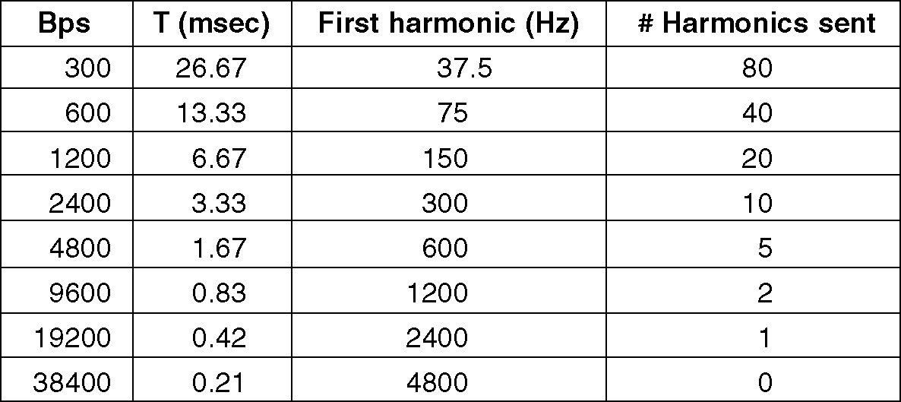
Bandwidth limits data rate
bps
f = 9600bps / 8 =1200 Hz
Data rate and harmonics
Obviously, for binary signal, data rates that higher than 38.4 kbps is impossible.
Notes:
Given a bit rate of b bits/sec, the time required to send 8 bits (for example) 1 bit at a time is 8/b sec, so the frequency of the first harmonic is b/8 Hz. An ordinary telephone line, often called a voice-grade line, has an artificially-introduced cutoff frequency just above 3000 Hz. This restriction means that the number of the highest harmonic passed through is roughly 3000/(b/8) or 24,000/b, (the cutoff is not sharp).
In other words, limiting the bandwidth limits the data rate, even for perfect channels.
However, coding schemes that make use of several voltage levels do exist and can achieve higher data rates.
For some data rates, the numbers work out as shown in Fig. 2-2. From these numbers, it is clear that trying to send at 9600 bps over a voice-grade telephone line will transform Fig. 2-1(a) into something looking like Fig. 2-1(c), making accurate reception of the original binary bit stream tricky. It should be obvious that at data rates much higher than 38.4 kbps, there is no hope at all for binary signals, even if the transmission facility is completely noiseless. In other words, limiting the bandwidth limits the data rate, even for perfect channels. However, sophisticated coding schemes that make use of several voltage levels do exist and can achieve higher data rates. We will discuss these later in this chapter.

Slide 19
Concept of Bandwidth
To electrical engineers, (analog) bandwidth is a quantity measured in Hz.
To Computer scientists, (digital) bandwidth is the maximum data rate of a channel, a quantity measured in bits/sec(bps).
The data rate is the end result of using the analog bandwidth of a physical channel for digital transmission, and the two are related.

Slide 20
Maximum Data Rate of A Channel --- noiseless channel
Nyquist’s theorem
It tries to talk about the realistic amount of data that can be pushed through a channel with a given bandwidth, H. If the signal consists of V levels (for example, binary = 2), then assuming no noise (i.e., perfect signals)
maximum data rate = 2 H log₂ V ( in bits/sec )
Notes:
Q: A noiseless 4-kHz channel is sampled every 1 msec. What is the maximum data rate?
A: A noiseless channel can carry an arbitrarily large amount of information, no
matter how often it is sampled. Just send a lot of data per sample. For the 4
kHz channel, make 8000 samples/sec. If each sample is 16 bits, the channel
can send 128 kbps. If each sample is 1024 bits, the channel can send 8.2
Mbps. The key word here is ‘‘noiseless.’’ With a normal 4 kHz channel, the
Shannon limit would not allow this.
As early as 1924, an AT&T engineer, Henry Nyquist, realized that even a perfect channel has a finite transmission capacity. He derived an equation expressing the maximum data rate for a finite bandwidth noiseless channel. In 1948, Claude Shannon carried Nyquist's work further and extended it to the case of a channel subject to random (that is, thermodynamic) noise (Shannon, 1948). We will just briefly summarize their now classical results here.
Nyquist proved that if an arbitrary signal has been run through a low-pass filter of bandwidth H, the filtered signal can be completely reconstructed by making only 2H (exact) samples per second. Sampling the line faster than 2H times per second is pointless because the higher frequency components that such sampling could recover have already been filtered out. If the signal consists of V discrete levels, Nyquist's theorem states:
Shanno’s Equation
香农信道容量公式，有扰连续信道的信道容量公式C=WLg（1+S/N）bps
1.提高信号与噪声功率之比能增加信道容量
2.当噪声功率N->0时，信道容量C趋于无穷，即无干扰信道容量为无穷大。
3.增加信道频带W并不能无限制的是信道容量增大。当噪声为白噪声时，随着W增大，噪声功率N=Wn0（n0为噪声的单边功率谱密度）也增大。
极限情况下limC=1.44S/n0
4.信道容量一定时，带宽和信噪比之间可以彼此互换

Slide 21
Maximum Data Rate of A Channel --- noisy channel
Signal to noise ratio - random (thermal) or interference causes a degradation of the signal. This is measured in terms of the ratio of signal power to noise power. Usually this is measured in decibels, in terms of 10 log₁₀ S/N. So an S/N of 100 = 20 dB.
Shannon’s formula
It is another way of expressing maximum data rate. It's given as
maximum data rate = H log₂ ( 1 + S/N )
( in bits/sec )
Notes:
S over N, ratio of S to N
理解香农公式须注意以下几点：
（1）信道容量由带宽及信噪比决定，增大带宽、提高信噪比可以增大信道容量；
（2）在要求的信道容量一定的情况下，提高信噪比可以降低带宽的需求，增加带宽可以降低信噪比的需求；
（3）香农公式给出了信道容量的极限，也就是说，实际无线制式中单信道容量不可能超过该极限，只能尽量接近该极限
扩频通信
从香农公式中还可以推论出：在信道带宽C不变的情况下，带宽B和信噪比S/N是可以互换的，也就是说，从理论上完全有可能在恶劣环境（噪声和干扰导致极低的信噪比）时，采用提高信号带宽（B）的方法来维持或提高通信的性能，甚至于可以使信号的功率低于噪声基底。简言之，就是可以用扩频方法以宽带传输信息来换取信噪比上的好处，这就是扩频通信的基本思想和理论依据。

Slide 22
Physical Media
Guided media:
signals propagate in solid media: copper, fiber, coax
Unguided media:
signals propagate freely, e.g., radio

Slide 23
2.2 Guided Transmission Media
Magnetic media
Twisted pairs
Coaxial cable
Power lines
Fiber optics

Slide 24
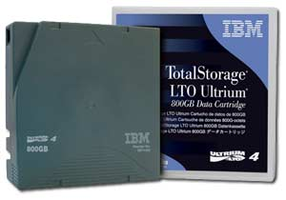
Magnetic Media
Write data onto magnetic media
Disks or Tapes
Data transmission speed
Ultrium tape (IBM LTO Ultrium 4)
Capacity : 800 Gigabytes /tape X 1000tapes/box
Bandwidth:
800*1000=800 terabytes/box/24hrs by FedEx
Never underestimate the bandwidth of a station wagon full of tapes hurtling down the highway
Notes:
One of the most common ways to transport data from one computer to another is to write them onto magnetic tape or removable media(e.g., recordable DVDs), physically transport the tape or disks to the destination machine, and read them back in again. Although this method is not as sophisticated as using a geosynchronous communication satellite, it is often more cost effective, especially for applications in which high bandwidth or cost per bit transported is the key factor.
IBM LTO Ultrium 4 800 GB Data Cartridge
High capacity tape media designed for high reliability
Highlights
High-capacity, high-reliability tape cartridge for LTO™ Ultrium™ Generation 4 storage environments
Provides 800 GB storage physical capacity (1.6 TB with 2:1 compression)
Available in rewritable and write once, read many cartridge (WORM) models
Data that is encrypted by LTO Ultrium 4 drives can be stored on both rewritable and WORM media to securely maintain data integrity
Designed to help improve read/write reliability by storing IBM’s statistical media read/write analysis on every use of the cartridge when using IBM LTO tape drives
Designed to adhere to widely supported Linear Tape-Open™ (LTO) Ultrium 4 design specifications
Higher capacity per volume requires less library cartridge capacity and helps reduce backup windows by requiring less volume mounts
Designed to help improve read/write reliability by storing IBM’s statistical media read/write analysis on every use of the cartridge when used with IBM LTO tape drives
Designed to adhere to widely supported Linear Tape-Open (LTO) Ultrium design specifications

Slide 25
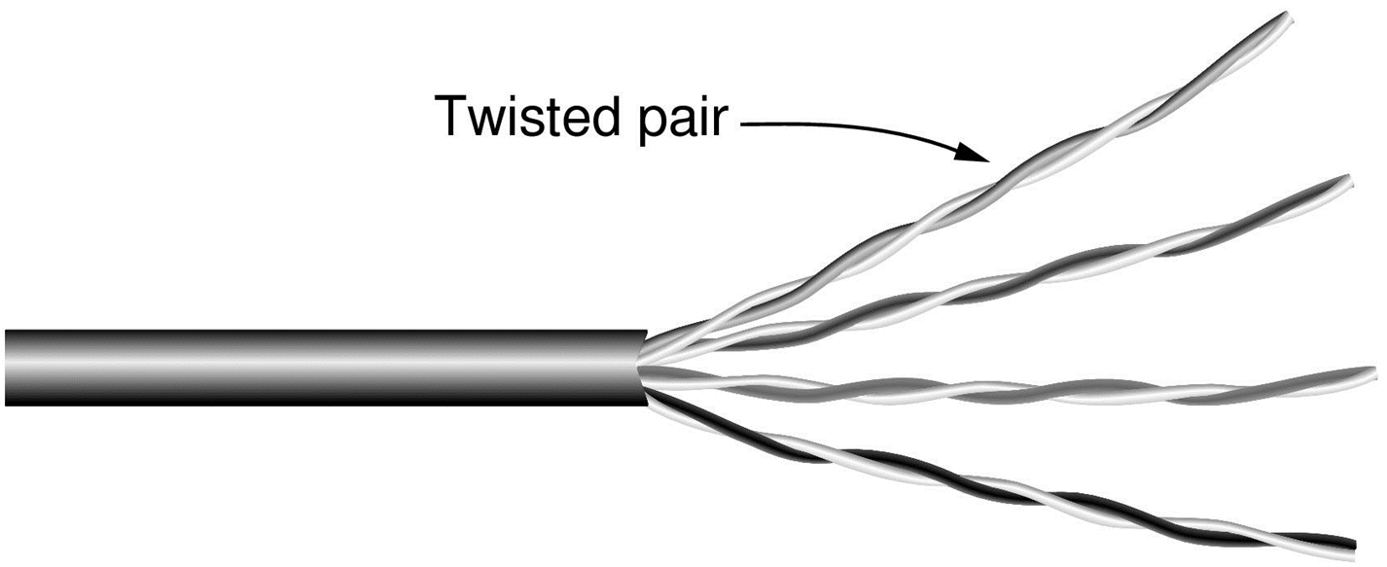
Twisted Pairs
Category 5 UTP cable with four twisted pairs
Notes:
insulate [ˈinsjuleit] vt. 使绝缘, 使隔热

Slide 26
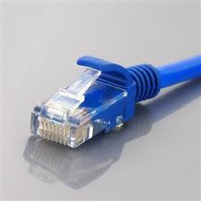
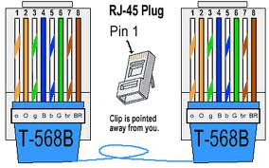
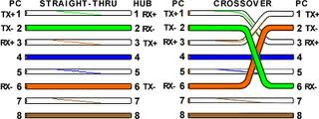
Cat5. Cabling
Bandwidth depends on the thickness of the wire and the distance traveled.
Cat5. >100MHz 100m
100Mbps Ethernet: 2pairs
1Gbps Ethernet: 4pairs
TIA/EIA 568B Standard
Notes:
Specifications for CAT5, CAT6 and CAT6e Cables
Category 5, 5e, 6, and 6e are progressively enhanced specifications for the Ethernet over twisted-pair cables. These networking cables contain several pairs of wires twisted together in order to reduce signal interference. Ethernet cables typically use an 8P8C (eight positions, eight contacts) modular connector and a common wiring schematic referenced by the Telecommunications Industry Association.
Category 5
Category 5 transmits at 100MHz frequencies, providing a rated line speed of up to 100Mbit/s and a max cable segment length of 100 meters. Most Category 5 cables, designed for early networks, only used two twisted pairs. Older Category 5 cables continue to make up the bulk of the world’s network infrastructure.
Category 5e
An improved specification to Category 5 was later introduced. By reducing noise and signal interference, Category 5e was capable of increasing rated transfer speeds to 350 Mbit/s over 100 meters. The new standard also required all cables to include four twisted pairs (all eight contacts). An optimized encoding scheme allows up to 50-meter lengths of Category 5e cable to perform at, or near, Gigabit Ethernet (1000BASE-T) speeds.
Category 6
The mainstream adoption of Gigabit Ethernet (1000BASE-T) required new industry-standard cables capable of transmitting at a higher frequency of 250 MHz. Category 6 cable uses thicker-gauge wire, increased shielding, and more pair twists per inch to reduce signal noise and interference. The tighter specifications guarantee that 100-meter runs of Category 6 are capable of 1000 Mbit/s transfer speeds. 10-Gigabit Ethernet speeds are achievable when reducing cable lengths to less than 50 meters.
Category 6e
Category 6 Enhanced (6e) is an augmented specification designed to double transmission frequency to 500 MHz. By wrapping Category 6e in grounded foil shielding, full 10-Gigabit Ethernet speeds can be reached without sacrificing the max cable length of 100 meters.
Ethernet Cable Wiring Specification
All Ethernet cables use either the T568A or T568B wiring standard. Mixing multiple cables is permitted, but using a different wiring standard on each end of a single cable will result in an Ethernet crossover cable.
T568A Pin 1 – White/Green – Pair 3, tip Pin 2 – Green– Pair 3, ring Pin 3 – White/Orange – Pair 2, tip Pin 4 – Blue – Pair 1, ring Pin 5 – White/Blue – Pair 1, tip Pin 6 – Orange – Pair 2, ring Pin 7 – White/Brown – Pair 4, tip Pin 8 – Brown – Pair 4, ring
T568B Pin 1 – White/Orange – Pair 2, tip Pin 2 – Orange – Pair 2, ring Pin 3 – White/Green – Pair 3, tip Pin 4 – Blue – Pair 1, ring Pin 5 – White/Blue – Pair 1, tip Pin 6 – Green – Pair 3, ring Pin 7 – White/Brown – Pair 4, tip Pin 8 – Brown – Pair 4, ring
Read more: Specifications for CAT5, CAT6 and CAT6e Cables | eHow.com http://www.ehow.com/about_6521486_specifications-cat5_-cat6-cat6e-cables.html#ixzz1nqqq42eV

Slide 27
Transmission Direction over Links
Links that can be used in both directions at the same time, like a two-lane road, are called full-duplex.
Links that can be used in either direction, but only one way at a time, like a single-track railroad line, are called half-duplex.
A third category consists of links that allow traffic in only one direction, like a one-way street, are called simplex links.

Slide 28
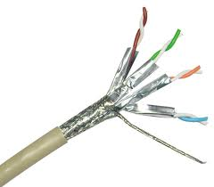
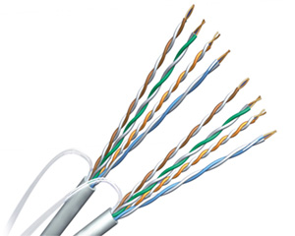
UTP, STP
Through Cat6. these wiring types are referred to as UTP (Unshielded Twisted Pair) as they consists simply of wires and insulators.
Cat7. cables have shielding on the individual twisted pairs, as well as around the entire cable, are referred to as STP.
Notes:
Shielding reduces the susceptibility to external interference and crosstalk with other nearby cables to meet demanding performance specifications.

Slide 29
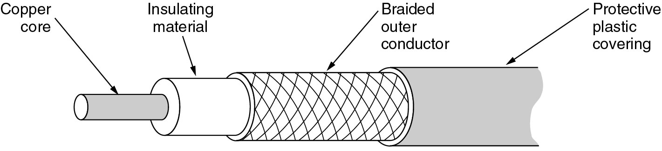
Coaxial Cable
A coaxial cable.
Two type
50-ohm: digital data (thin coaxial cable)
75-ohm cable TV
Bandwidth: > 1 GHz
Notes:
coaxial [kəuˈæksəl] adj. 同轴的,共轴的 thin coaxial thick
braided ['breidid] 编织的
Cutaway view
The construction and shielding of coaxial cable give it a good combination of high bandwidth and excellent noise immunity. The bandwidth possible depends on the cable quality and length. Modern cables have a bandwidth of up to a few GHz.

Slide 30
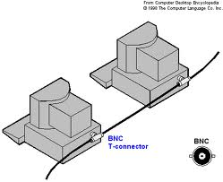
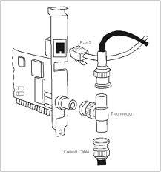
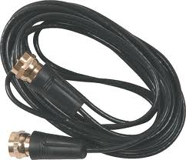
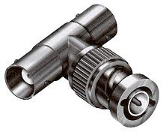
Thin Coaxial cable
Notes:
10base-2 Ethernet BNC Connector

Slide 31
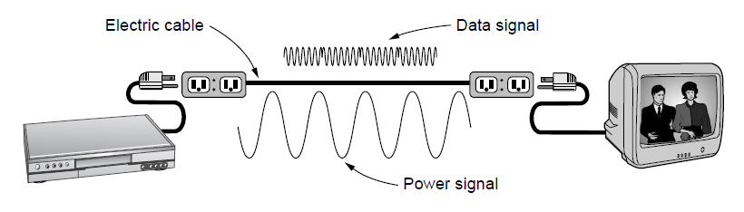
Power Lines
A network that uses household electrical wiring.
Notes:
> 100Mbps Standards are actively under development.
Power lines deliver electrical power to house and electrical wiring within houses distributes the power to electrical outlets.
The difficulty with using household electrical wiring for a network is that it was designed to distribute power signals.
This task is quite different than distributing data signal, at which house hold wiring does a horrible job.
Electrical signals are sent at 50-60Hz and the wiring attenuates the much higher frequency (MHz) signals needed for high-rate data communication.
Electrical noise, power switch
Transient current 瞬时电流
No twisted pairing antenna radio

Slide 32
Race between computing and communication
Single CPUs(3 GHz) are beginning to approach physical limits, which is why now the number of CPUs is increased per chip.
The achievable bandwidth with fiber technology is in excess of 50Tbps.
The current practical limit of around 100Gbps is due to our inability to convert between electrical and optical signals any faster.

Slide 33
Fiber Optics
Fiber usages
Long-haul transmission in network backbones
High-Speed LANs
High-Speed Internet Access (FttH)
Components of Optical Transmission System
The light source
The transmission medium
The detector
Notes:
An optical transmission system has three key components: the light source, the transmission medium, and the detector.
Conventionally, a pulse of light indicates a 1 bit and the absence of light indicates a 0 bit.
The transmission medium is an ultra-thin fiber of glass.
The detector generates an electrical pulse when light falls on it.
By attaching a light source to one end of an optical fiber and a detector to the other, we have a unidirectional data transmission system that accepts an electrical signal, converts and transmits it by light pulses, and then reconverts the output to an electrical signal at the receiving end.

Slide 34
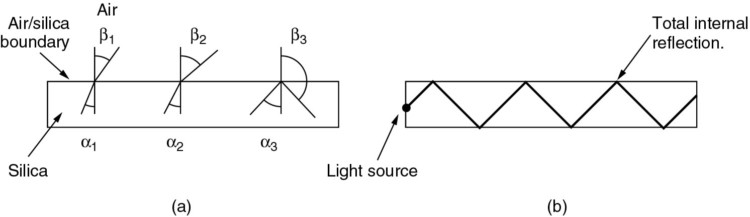
Fiber Optics
(a) Three examples of a light ray from inside a silica fiber impinging on the air/silica boundary at different angles.
(b) Light trapped by total internal reflection.
Notes:
incident ['insidənt] adj. [光] 入射的；
Incidence
silica [ˈsilikə] n. 硅石, 二氧化硅
Fused 变形:
refracted [ri'frækt] 折射 bent
Refraction 折射
impinging [im'pindʒiŋ] v. 冲击，撞击（impinge的现在分词形式）
impinge on 影响；撞击；侵犯；紧密接触
This transmission system would leak light and be useless in practice except for an interesting principle of physics. When a light ray passes from one medium to another, for example, from fused silica to air, the ray is refracted (bent) at the silica/air boundary, as shown in Fig. 2-5(a). Here we see a light ray incident on the boundary at an angle a₁ emerging at an angle b₁. The amount of refraction depends on the properties of the two media (in particular, their indices of refraction).
For angles of incidence above a certain critical value, the light is refracted back into the silica; none of it escapes into the air. Thus, a light ray incident at or above the critical angle is trapped inside the fiber, as shown in Fig. 2-5(b), and can propagate for many kilometers with virtually no loss.

Slide 35
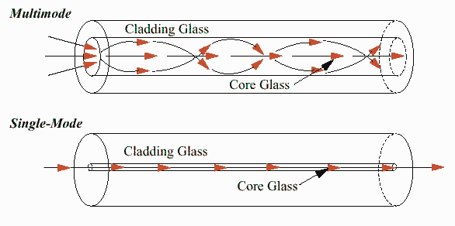
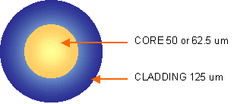
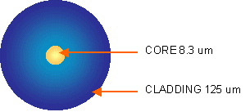
Multimode and Single-mode
different rays will be bouncing around at different angles. Each ray is said to have a different mode, so a fiber having this property is called a multimode fiber .
if the fiber's diameter is reduced to a few wavelengths of light, the fiber acts like a wave guide, and the light can propagate only in a straight line, without bouncing, yielding a single-mode fiber.
Notes:
diameter [dai'æmitə] n. 直径
Cladding Glass 覆盖
Fiber cable types
"Multi-mode" vs. "Single-mode" describes two different kinds of fiber cable.
Multi-mode cable has a thick core:
Single-mode cable has a thin core:
Light travels through a multi-mode fiber in many directions, whereas it travels through a single-mode fiber in only one direction:
Single-mode cable is more expensive and more difficult to terminate, but is good for vastly greater distances.
IMC Networks has a good paper on the above subject for further explanation. Click here.
Lanshack also has a very good general tutorial on fiber optics. Click here.

Slide 36
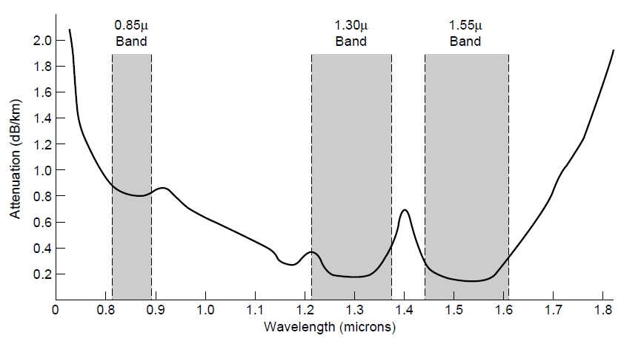
Transmission of Light through Fiber
All three bands are 25,000 to 30,000 GHz wide
Attenuation of light through fiber in the infrared region.
Notes:
[ˈinfrəˈred]
adj.
〈物〉红外线的

Slide 37
Chromatic Dispersion
Chromatic dispersion occurs because different colors of light travel through the fiber at different speeds. Since the different colors of light have different velocities, some colors arrive at the fiber end before others.
It has been discovered that making the pulsed in a special shape related to the reciprocal of the hyperbolic cosine causes nearly all the dispersion effects cancel out. These pulses are called solitons.
Notes:
soliton ['sɔlitɔn] n. 孤子，光孤子；孤立子；孤波
reciprocal [ri'siprəkəl] adj. 相互的；互惠的；倒数的，彼此相反的
hyperbolic [,haipə'bɔlik] adj. 双曲线的；夸张的
So it is possible to send pusles for thousands of kilometers with out appreciable shape distortion.
A considerable amount of research is going on to take solitons out of the lab and into the field.
Chromatic Dispersion
Chromatic, or intramodal, dispersion occurs in both single mode and multimode optical fibers. Chromatic dispersion occurs because different colors of light travel through the fiber at different speeds. Since the different colors of light have different velocities, some colors arrive at the fiber end before others. This delay difference is called the differential group delay &tau;(&lambda;) per unit length. This differential group delay leads to pulse broadening.
Chromatic dispersion is measured using EIA/TIA-455-168 in the time domain. Chromatic dispersion is also measured in the frequency domain using EIA/TIA-455-169 and EIA/TIA-455-175. These methods measure the composite optical fiber material and waveguide dispersion. To understand the contribution that material and waveguide dispersive mechanisms have on multimode and single mode fiber dispersion, refer to chapter 2. In this chapter we limit the discussion on chromatic dispersion to the time domain method described in EIA/TIA-455-168.
The chromatic dispersion of multimode graded-index and single mode fiber is obtained by measuring fiber group delays in the time domain. These measurements are made using multiwavelength sources or multiple sources of different wavelengths. A multiwavelength source could be a wavelength-selectable laser.
The pulse delay for both a long test sample fiber and a short reference fiber are measured over a range of wavelengths. The pulse delay for the reference fiber as a function of wavelength is &tgr;in(&lambda;). The pulse delay for the test fiber as a function of wavelength is &tgr; out(&lambda;). The group delay &tgr;(&lambda;). per unit length at each wavelength is
where Ls is the test sample fiber length in kilometers (km) and Lref is the reference sample length in km.
The fiber chromatic dispersion is defined as the derivative, or slope, of the fiber group delay curve with respect to wavelength. Generally, the group delay as a function of wavelength is fit to a simple mathematical function and the derivative calculated. The range of wavelengths over which meaningful data is obtained depends on the wavelength range of optical source(s) used. The zero-dispersion wavelength (&lambda;0) and the zero-dispersion slope (S0) are determined from the chromatic dispersion curve.
Q.12 Delay differences between the source wavelengths occur as the optical signal propagates along the fiber. What is this called? Q.13 What determines the range of wavelengths over which meaningful data is obtained for calculating the chromatic dispersion?
色散的分类
光纤的色散主要由模式色散、材料色散和波导色散组成。其中，材料色散与波导色散都与波长有关，所以又统称为波长色散。
模式色散
在多模光纤中，传输的模式很多，不同的模式，其传输路径不同，所经过的路程就不同，达终点的时间也就不同，这就引起了脉冲的展宽。对模式色散进行的严密分析比较复杂，这里仅作简单讨论。我们知道，在同一根光纤中，高次模到达终点走的路程长，低次模走的路程短，这就意味着高次模到达终点需要的时间长，低次模到达点需要的时间短。在同一条长度为的光纤上，最高次模与最低次模到达终点所用的时间差，就是这段光纤产生的脉冲展宽。
影响光纤时延差的因素有两个：纤芯－包层相对折射率差和光纤的长度。光纤的时延差与纤芯－包层相对折射率差成正比。其中是纤芯的折射率，是包层的折射率。越大，时延差就会越大，光脉冲展宽也越大。从减小光纤时延差的观点上看，希望较小为好，这种小的光纤称为弱导光纤。通信用光纤都是弱导光纤。另外，光纤越长，时延差也越大，色散也越大。
材料色散
材料色散是由光纤材料自身特性造成的。石英玻璃的折射率，严格来说，并不是一个固定的常数，而是对不同的传输波长有不同的值。光纤通信实际上用的光源发出的光，并不是只有理想的单一波长，而是有一定的波谱宽度。当光在折射率n的为介质中传播时，其速度v与空气中的光速C之间的关系为： v=C/n
光的波长不同，折射率n就不同，光传输的速度也就不同。因此，当把具有一定光谱宽度的光源发出的光脉冲射入光纤内传输时，光的传输速度将随光波长的不同而改变，到达终端时将产生时延差，从而引起脉冲波形展宽。
波导色散
光纤的第三类色散是波导色散。由于光纤的纤芯与包层的折射率差很小，因此在交接口产生全反射时，就可能有一部分光进入包层之内。这部分光在包层内传输一定距离后，又可能回到纤芯中继续传输。进入包层内的这部分光强的大小与光波长有关，这就相当于光传输路径长度随光波波长的不同而异。把有一定波谱宽度的光源发出的光脉冲射入光纤后，由于不同波长的光传输路径不完全相同，所以到达终点的时间也不相同，从而出现脉冲展宽。具体来说，入射光的波长越长，进入包层中的光强比例就越大，这部分光走过的距离就越长。这种色散是由光纤中的光波导引起的，由此产生的脉冲展宽现象叫做波导色散。
三种色散的比较
一般来说，光纤三种色散的大小顺序是：
模式色散>材料色散>波导色散
对于多模光纤，总色散等于三者相加，在限制带宽方面起主导作用的是模式色散，其它两个色散影响很小。
对于单模光纤，因只有一个传输模式，故不存在模式色散，其总色散为材料色散和波导色散之和。为减小总的波长色散，要尽量选用窄谱线激光器作光源。
对光纤用户来说，一般只关心光纤的总带宽或总色散。光纤光缆在出厂时，也只标明光纤的总带宽或总色散。

Slide 38
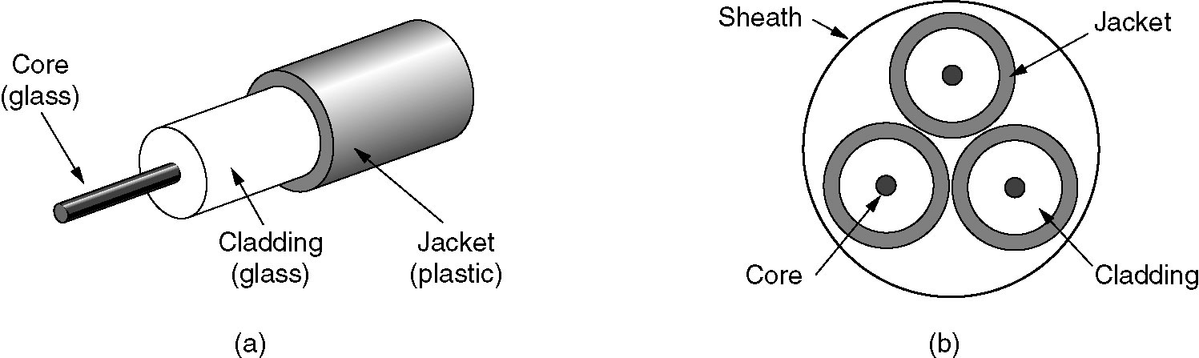
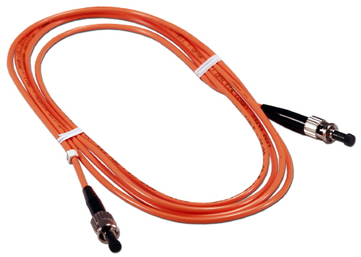
Fiber Cables
(a) Side view of a single fiber.
(b) End view of a sheath with three fibers.
Diameter:50um of Multimode
<10um of singlemode
Notes:
sheath [ʃi:θ] n. 鞘；护套；叶鞘；女子紧身服装
cladding ['klædiŋ] n. 包层
The core is surrounded by a glass cladding with a lower index of refraction than the core, to keep all the light in the core.
Next comes a thin plastic jacket to protect the cladding. Fibers are typically grouped in bundles, protected by an outer sheath.
Terrestrial fiber sheaths are normally laid in the ground within a meter of the surface, where they are occasionally subject to attacks by backhoes or gophers.
Near the shore, transoceanic fiber sheaths are buried in trenches by a kind of seaplow.
In deep water, they just lie on the bottom, where they can be snagged by fishing trawlers or attacked by giant squid.

Slide 39
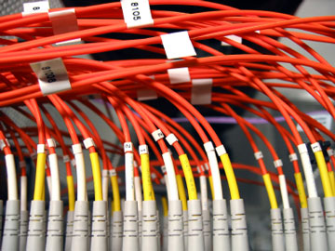
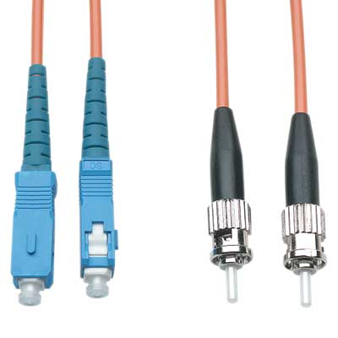
Connecting Fibers
Fibers can be connected in three different ways：
Connectors and fiber sockets
Mechanical splices
Fusion (melted) splice
Notes:
Splice 拼接
Fusion 熔接

Slide 40
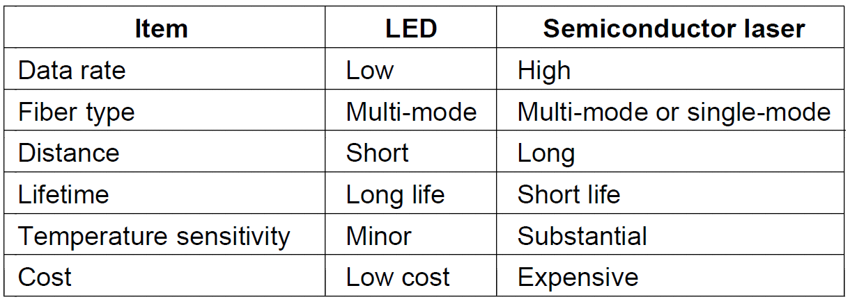
Light Sources
Two kinds of light resources are typically used to do the signaling:
A comparison of semiconductor diodes and LEDs as light sources.
Notes:
diode ['daiəud] n. [电]二极管

Slide 41
The receiving end
Photodiode: gives off an electrical pulse when struck by light
The response time of photodiodes, which convert the signal from the optical to the electrical domain, limits data rates to about 100Gbps.
Thermal noise is also an issue, so a pulse of light must carry enough energy to be detected, by making the pulses powerful enough, the error rate can be made arbitrarily small.
Notes:
photodiode
[ˌfəutəuˈdaiəud]
n.
光敏二极管,光电二极管

Slide 42
Pros and Cons of Fiber Optics
Pros
High bandwidth
Long distance, low attenuation
No being affected by power surges, electromagnetic interference, or power failures
Thin and lightweight
No light leaking, difficult to tap
Cons
Requiring skills to install
Can be damaged by being bent too much
Two-way communication requires either two fibers or two frequency bands on one fiber
Fiber interfaces cost more than electrical interfaces.

Slide 43
2.3 Wireless Transmission
The Electromagnetic Spectrum
Radio Transmission
Microwave Transmission
Infrared Transmission
Lightwave Transmission

Slide 44
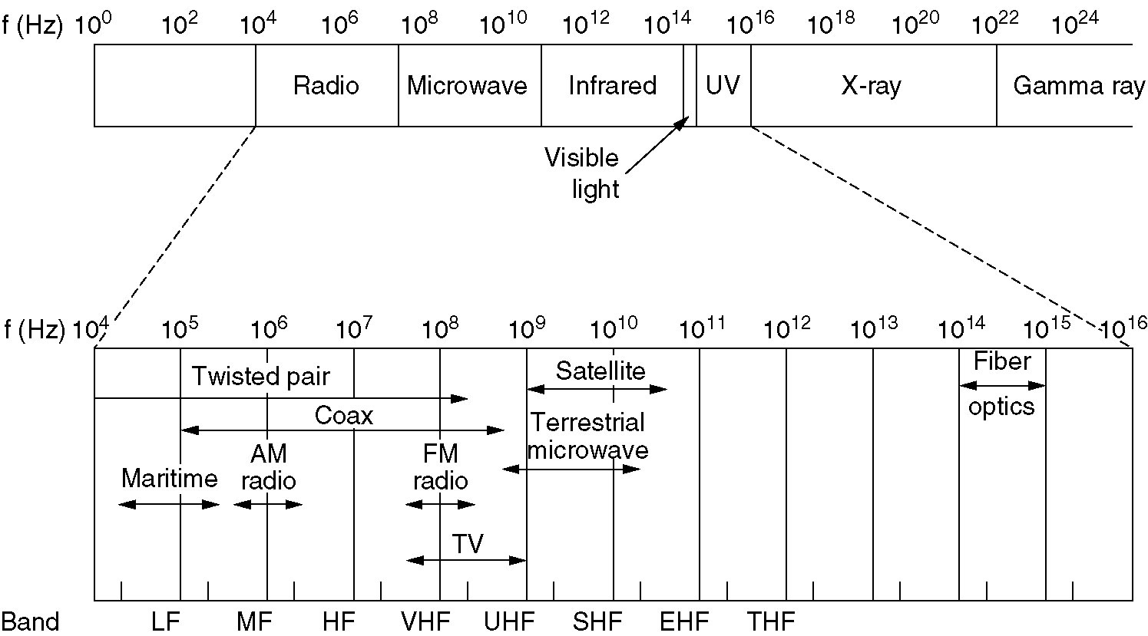
The Electromagnetic Spectrum
Ultraviolet
The electromagnetic spectrum and its uses for communication.
Notes:
When electrons move, they create electromagnetic waves that can propagate through space (even in a vacuum).
Electromagnetic wave
Predicted by British physicist James Clerk Maxwell in 1865
First observed by German physicist Heinrich Hertz in 1887
To prevent total chaos, there are national and international agreements about who gets to use which frequencies. Since everyone wants a higher data rate, everyone wants more spectrum. National governments allocate spectrum for AM and FM radio, television, and mobile phones, as well as for telephone companies, police, maritime, navigation, military, government, and many other competing users. Worldwide, an agency of ITU-R (WARC) tries to coordinate this allocation so devices that work in multiple countries can be manufactured. However, countries are not bound by ITU-R's recommendations, and the FCC (Federal Communication Commission), which does the allocation for the United States, has occasionally rejected ITU-R's recommendations (usually because they required some politically-powerful group giving up some piece of the spectrum).
Even when a piece of spectrum has been allocated to some use, such as mobile phones, there is the additional issue of which carrier is allowed to use which frequencies. Three algorithms were widely used in the past. The oldest algorithm, often called the beauty contest, requires each carrier to explain why its proposal serves the public interest best. Government officials then decide which of the nice stories they enjoy most. Having some government official award property worth billions of dollars to his favorite company often leads to bribery, corruption, nepotism, and worse. Furthermore, even a scrupulously honest government official who thought that a foreign company could do a better job than any of the national companies would have a lot of explaining to do.
This observation led to algorithm 2, holding a lottery among the interested companies. The problem with that idea is that companies with no interest in using the spectrum can enter the lottery. If, say, a fast food restaurant or shoe store chain wins, it can resell the spectrum to a carrier at a huge profit and with no risk.
Bestowing huge windfalls on alert, but otherwise random, companies has been severely criticized by many, which led to algorithm 3: auctioning off the bandwidth to the highest bidder. When England auctioned off the frequencies needed for third-generation mobile systems in 2000, they expected to get about $4 billion. They actually received about $40 billion because the carriers got into a feeding frenzy, scared to death of missing the mobile boat. This event switched on nearby governments' greedy bits and inspired them to hold their own auctions. It worked, but it also left some of the carriers with so much debt that they are close to bankruptcy. Even in the best cases, it will take many years to recoup the licensing fee.

Slide 45
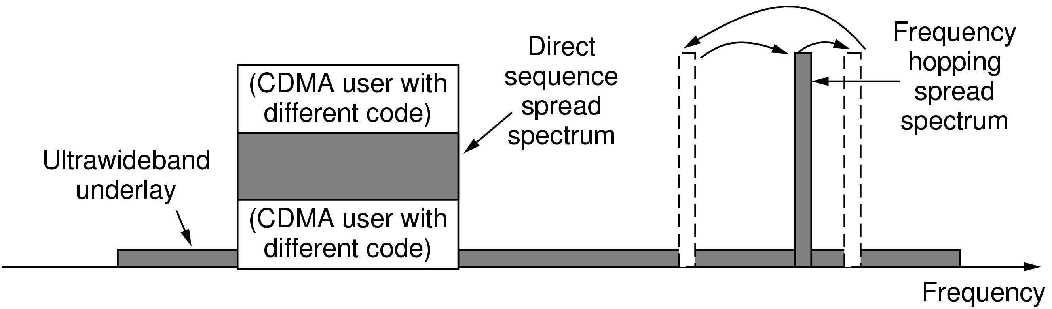
Spread spectrum & UWB
Spread spectrum and ultra-wideband (UWB) communication
Notes:
Most transmissions use a relatively narrow frequency band.
They concentrate their signals in this narrow band to use the spectrum efficiently and obtain reasonable data rates by transmitting with enough power.
How ever in some cases, a wider band is used, with three variations.
In Frequency hopping spread spectrum, the transmitter hops from frequency to frequency hundreds of time per second. It is popular for military communication because it makes transmissions hard to detect and next to impossible to jam.
Direct sequence spread spectrum uses a code sequence to spread the data signal over a wider frequency band. It is used commercially as a spectrally efficient way to let multiple signals share the same frequency band. These signals can be given different codes, the method is called CDMA(Code Division Multiple Access) . It forms the basis of 3G mobile phone networks and GPS.
A 3rd method of communication with a wider band is UWB communication. UWB sends a series of rapid pulses, varying their positions to communicate information. The rapid transitions lead to a signal that is spread thinly over a very wide frequency band.
Just as importantly, since UWB has very little energy at any given frequency when used for short-range transmission, it does not cause harmful interference to those other narrowband radio signals. It is said to underlay the other signals. This peaceful coexistence has led to its application in wireless PANs that run at up to 1Gbps, although commercial success has been mixed.

Slide 46
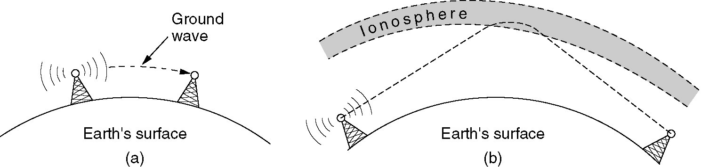
Radio Transmission
(a) In the VLF, LF, and MF bands, radio waves follow the curvature of the earth.
(b) In the HF band, they bounce off the ionosphere.
Notes:
ionosphere [aiˈɔnəsfiə] n. 电离层

Slide 47
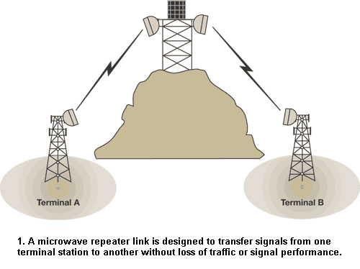
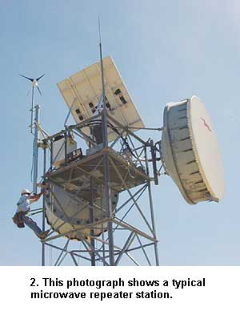
Microwave Transmission
Above 100MHz, the waves travel in nearly straight lines and can therefore be narrowly focused. Concentrating all the energy into a small beam by means of a parabolic antenna gives a much higher S/N ration, but the transmitting and receiving antennas must be accurately aligned with each other.
Notes:
Microwave communication is so widely used for long –distance telephone communication, mobile phones, television distribution, and other purposes that a severe shortage of spectrum has developed. It has several key advantages over fiber. The main one is that no right of way is needed to lay down cables. By buying a mall plot of ground every 50km and putting microwave tower on it, one can bypass the telephone system entirely.

Slide 48
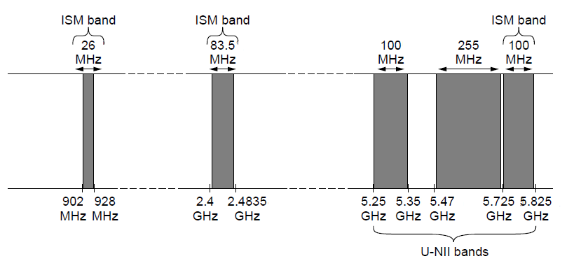
Politics of the Electromagnetic Spectrum
ISM (Industrial, Scientific, Medical) and U-NII (Unlicensed National Information Infrastructure) bands used in the United States by wireless devices
Notes:
Three algorithms were widely used in the past for a company to use a frequency. Beauty contest. Lottery, Auction.
A completely different approach to allocating frequencies is to not allocate them at all. Just let everyone transmit at will but regulate the power used so that stations have such a short range they do not interfere with each other. Accordingly, most governments have set aside some frequency bands, called the ISM (Industrial, Scientific, Medical) bands for unlicensed usage. Garage door openers, cordless phones, radio-controlled toys, wireless mice, and numerous other wireless household devices use the ISM bands. To minimize interference between these uncoordinated devices, the FCC mandates that all devices in the ISM bands use spread spectrum techniques. Similar rules apply in other countries.

Slide 49
Popular Bands
900MHz band works best, but it is crowded and not available worldwide
2.4GHz band is available in most countries, but it is subject to interference from microwave ovens and radar installation.
Bluetooth and 802.11b/g
5GHz band
802.11a
Notes:
全球GSM频段分为4段，即850/900/1800/1900（MHz），这4个频段又分为两个阵营，美国及北美地区使用的是850 /1900（MHz）频段，中国、欧洲等其它大部分地区使用的是900/1800（MHz）频段。因此，美国的双频设备在国内是不能使用的，除非它支持3 频或4频，而美国的3频模式通常是850/1800/1900（MHz），对应国内的3频模式通常是900/1800/1900（MHz），即3频里增加 的那个频段都是对方的高频部分。 我国的GSM频段是从900MHz开始发展的，随着用户量增加，频率资源不足，才开始增加1800MHz频段。因此，900MHz频段是很普及 的，而1800MHz频段不是到处都有的，只在手机用量大的地方才有，作为对900MHz频段补充。所以1800MHz频段的信号通常只有在市区才有，而 且是较大的城市。
390N的支持频段始终没有查到，但根据上述及使用的经验，可以推测它应该是个3频设备，即支持的是850/1800/1900（MHz），这就可 以解释为什么390N只有在靠近市区才可以接收到信号，而普通手机的信号却到处都有。这样看来，390N虽然甩掉了那个小尾巴，看起来很舒服，但用起来却 很受限制，毕竟，人家是为美国人设计的！
中国移动的频段： 900频段 885MHz—909MHz（上行） 930MHz—954MHz（下行） 1800频段 1710MHz—1725MHz（上行） 1805MHz—1820MHz（下行）
中国联通的频段： 900频段 909MHz—915MHz（上行） 954MHz—960MHz（下行） 1800频段 1745MHz—1755MHz（上行） 1840MHz—1850MHz（下行）
美国GSM频段： 850频段 824MHz—849MHz（上行） 869MHz—894MHz（下行） 1900频段 1850MHz—1910MHz（上行） 1930MHz—1990MHz（下行）

Slide 50
2.4 Communication Satellites
Geostationary Satellites
Medium-Erath Orbit Satellites
Low-Earth Orbit Satellites
Satellites Versus Fiber

Slide 51
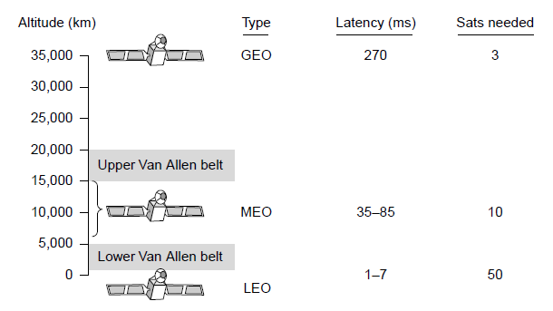
Communication satellites
Communication satellites, some properties, including: altitude above earth, round-trip delay time, number of satellites for global coverage.

Slide 52
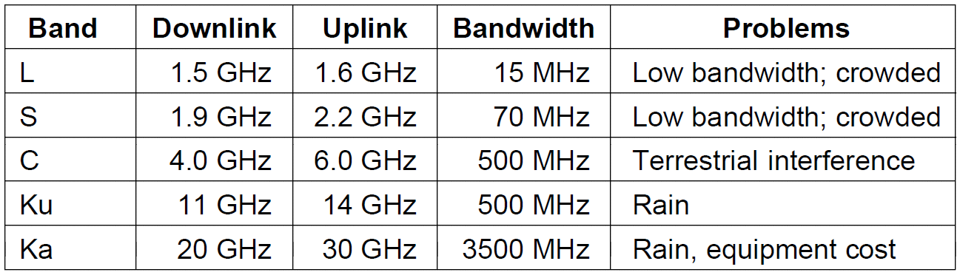
The principal satellite bands

Slide 53
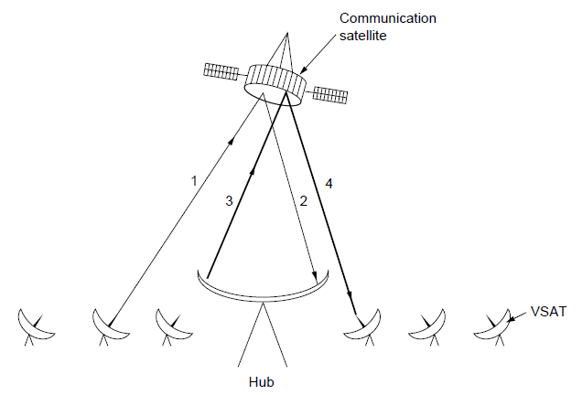
Geostationary Satellites
VSATs using a hub.

Slide 54
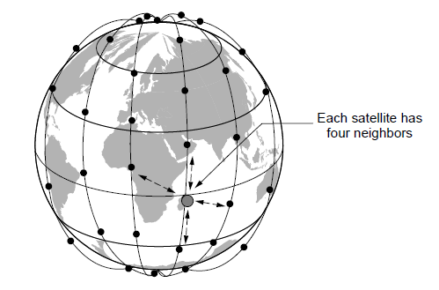
Low-Earth Orbit Satellites
The Iridium satellites form six necklaces around the earth.

Slide 55
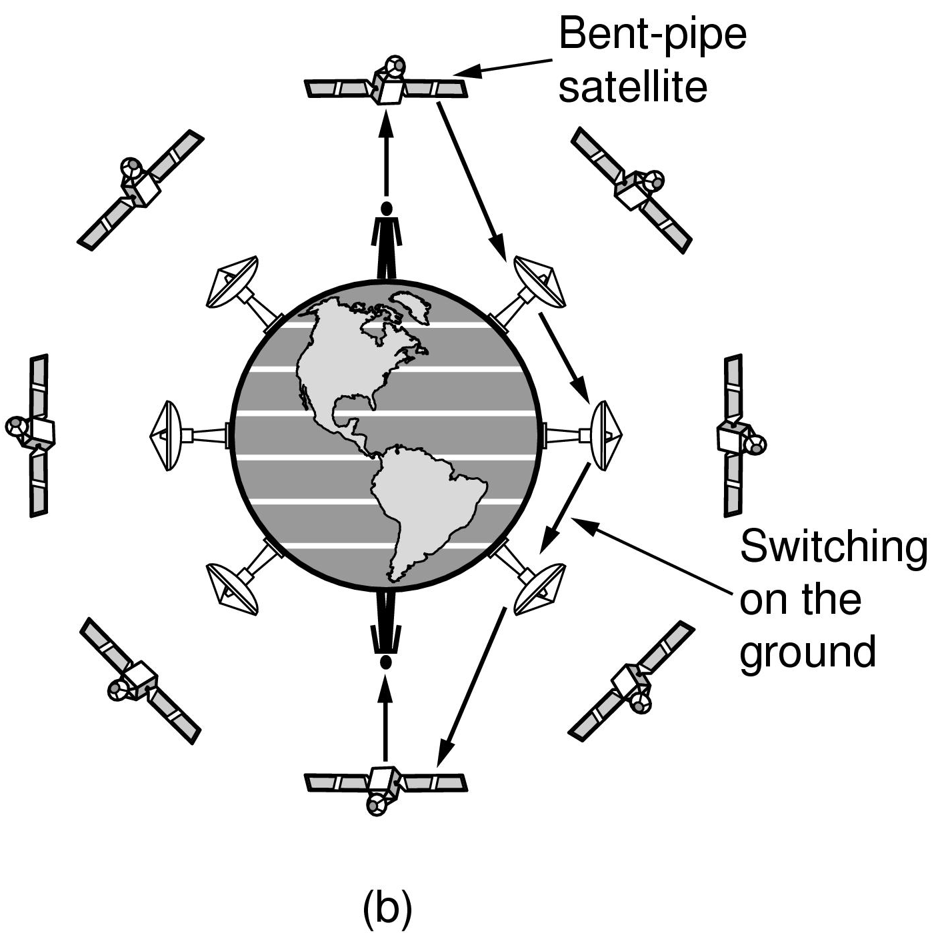
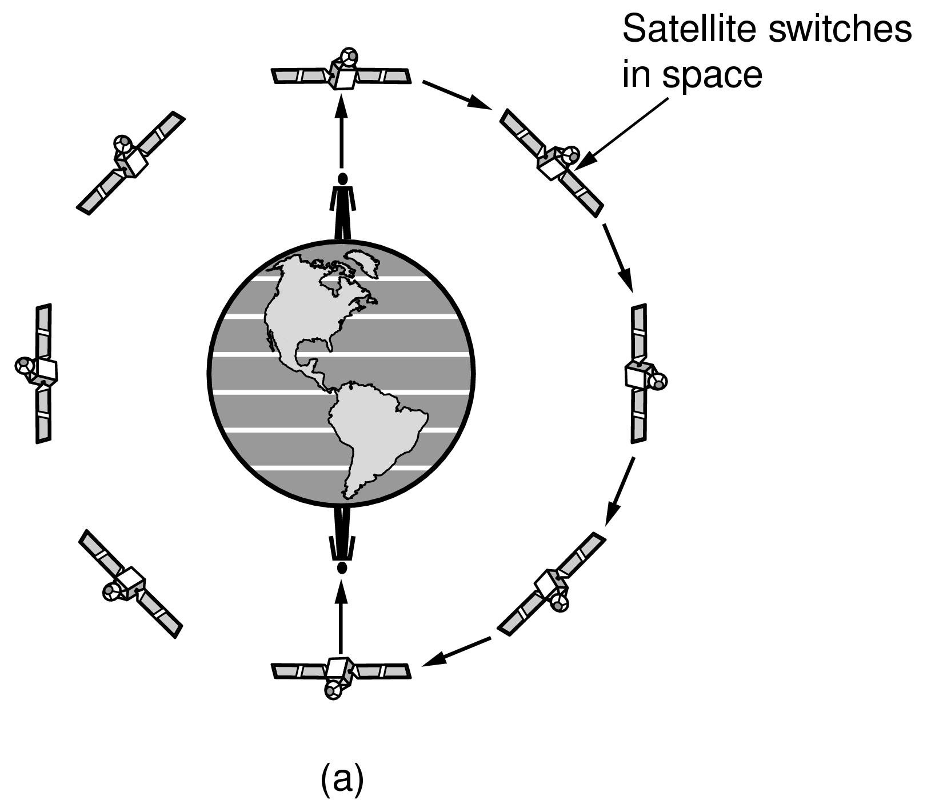
Relaying
(a) Relaying in space. (b) Relaying on the ground

Slide 56
2.5 Digital modulation and multiplexing
Baseband Transmission
Passband Transmission
Frequency Division Multiplexing
Time Division Multiplexing
Code Division Multiplexing

Slide 57
Terms
The process of converting between bits and signals that represent them is called digital modulation.
Schemes that directly convert bits into a signal result in baseband transmission. It is common for wires.
Schemes that regulate/modulate the amplitude, phase, or frequency of a carrier signal to convey bits result in passband transmission. It is common for wireless and optical channels for which the signals must reside in a given frequency band.
Channels are often shared by multiple signals. It is called multiplexing.
Notes:
Now that we have studied the properties of wired and wireless channels, we turn our attention to the problem of sending digital information.
Wires and wireless channels carry analog signals such as continuously varying voltage, light intensity, or sound intensity.
To send digital information, we must devise analog signals to represent bits.

Slide 58
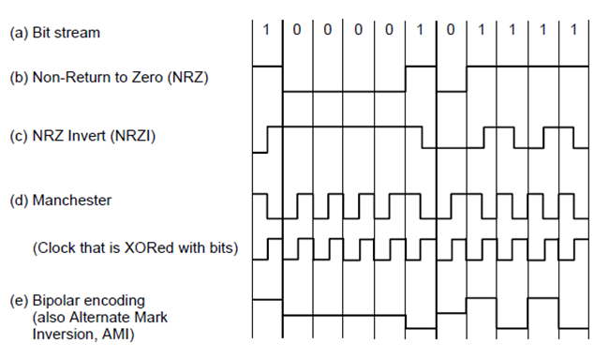
Baseband Transmission
Line codes: (a) Bits, (b) NRZ, (c) NRZI, (d) Manchester, (e) Bipolar or AMI.
Notes:
The most straightforward form of digital modulation is to use a positive voltage to represent a 1 and a negative voltage to represent a 0. for an optical fiber, the presence of light might represent a 1 and the absence of light might represent a 0.

Slide 59
Bandwidth efficiency
One strategy for using limited bandwidth more efficiently is to use more than two signaling levels.
By using four voltages, for instance, we can send 2 bits at once as a single symbol.
The rate at which the signal changes is then half the bit rate. So the needed bandwidth has been reduced.
Notes:
This design will work as long as the signal at the receiver is sufficiently strong to distinguish the four level.

Slide 60
Bit rate and symbol rate
We call the rate at which the signal changes the symbol rate to distinguish it from the bit rate.
The bit rate(an older name is baud rate) is the symbol rate multiplied by the number of bits per symbol.
If the signal is BINARY (only two voltage levels), then the bit rate is equal to the symbol rate.
Notes:
In the literature, the terms “bit rate” and “baud rate” are often used incorrectly.

Slide 61
Clock Recovery
For all schemes that encode bits into symbols, the receiver must know when one symbol ends and the next symbol begins to correctly decode the bits.
Manchester encoding: mix the clock signal with the data signal by XORing them together so that no extra line is needed. But the downside is that it requires twice as much bandwidth as NRZ because of the clock.
Notes:
Used for classic Ethernet

Slide 62
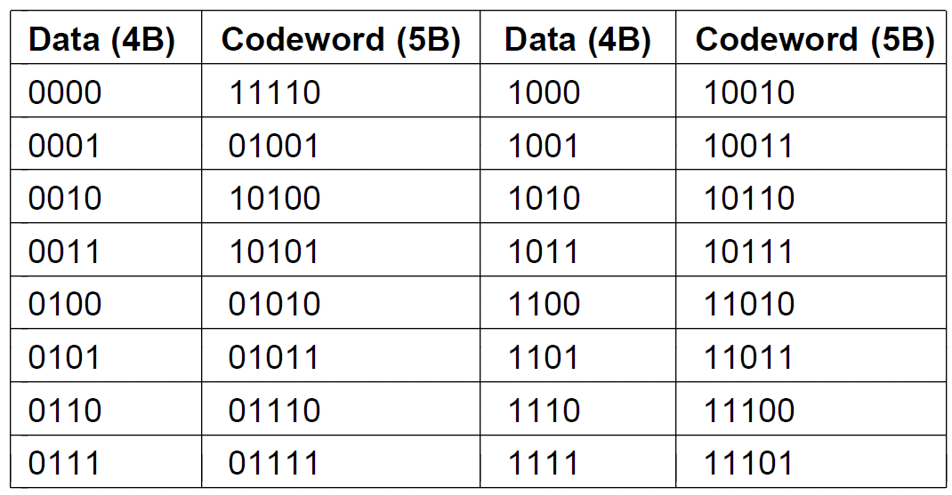
Code pattern to break consecutive 0s
4B/5B mapping.

Slide 63
Balanced Signals
Signals that have as much positive voltage as negative voltage even over short periods of time are called balanced signals.
Balancing helps to provide transitions for clock recovery and provides a simple way to calibrate receivers.
A straightforward way to construct a balanced code is to use two voltage levels represent a logical 1, (say +1v or -1v) with 0v representing a logical zero. To send a 1, the transmitter alternates between the +1v and -1v levels to that they always average out. The scheme is called bipolar encoding (AMI, Alternate Mark Inversion).
Notes:
They average to zero, which means that they have no DC electrical component. The lack of a DC component is an advantage because some channels, such as coaxial cable or line with transformers, strongly attenuate a DC component due to their physical properties.
Also, one method of connecting the receiver to the channel call capacitive coupling, passes only the AC portion of a signal.
电容耦合
In either case, if we send a signal whose average is not zero, we waste energy as the DC component will be filtered out.
Balancing helps to provide transitions for clock recovery and provides a simple way to calibrate receivers because the average of the signal can be measured and used as a decision threshold to decode symbos.

Slide 64
Passband Transmission
We can take a baseband signal that occupies 0 to B Hz and shift it up to occupy a passband of S to S+B Hz without changing the amount of information that it can carry, even though the signal will look different.
To process a signal at the receiver, we can shift it back down to baseband, where it is more convenient to detect symbols.

Slide 65
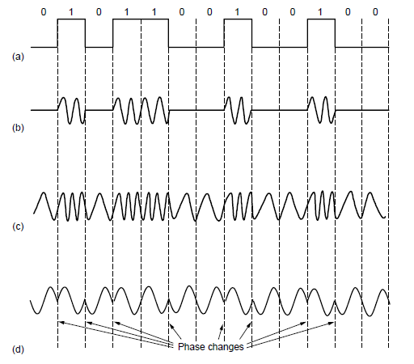
Digital modulation
(a) A binary signal. (b) Amplitude shift keying. (c) Frequency shift keying. (d) Phase shift keying.
Notes:
Digital modulation is accomplished with passband transmission by regulating or modulating a carrier signal that sits in the passband.
We can modulate the amplitude, frequency, or phase of the carrier signal.
Each of these methods has a corresponding name.

Slide 66
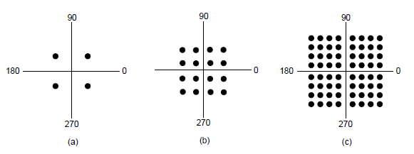
More bits per symbol
Amplitude and phase are modulated in combination.
Constellation diagram
(a) QPSK. (b) QAM-16. (c) QAM-64.
Notes:
Constellation diagram
constellation [,kɔnstə'leiʃən]

Slide 67
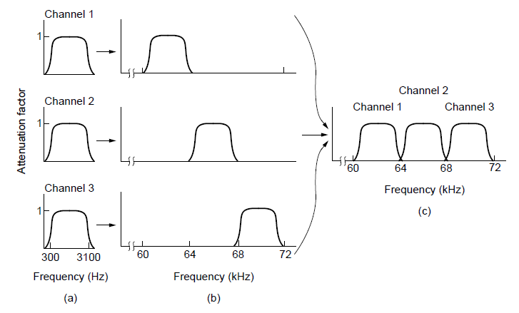
Frequency Division Multiplexing
Frequency division multiplexing. (a) The original bandwidths. (b) The bandwidths raised in frequency. (c) The multiplexed channel.
Notes:
Consequently, multiplexing schemes have been developed to share lines among many signals.
FDM takes advantage of passband transmission to share a channel. Ti divides the spectrum into frequency bands, with each user having exclusive possession of some band in which to send their signal.

Slide 68
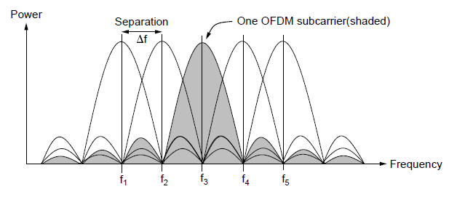
Digital data transmission
Orthogonal frequency division multiplexing (OFDM).
Notes:
Orthogonal [ɔː'θɒg(ə)n(ə)l]
When sending digital data, it is possible to divide the spectrum efficiently without using guard bands.
In OFDM, the channel bandwidth is divided into many subcarriers that independently send data (e.g. with QAM).
The subcarriers are packed tightly together in the frequency domain. Thus, signals from each subcarrier extend into adjacent ones.
The frequency response of each subcarrier is designed so that it is zero at the center of the adjacent subcarrier. The subcarriers can therefore be sampled at their center frequencies without interference from their neighbors.
The idea of OFDM has been around for a long time, but it is only in the last decade that it has been widely adopted, following the realization that it is possible to implement OFDM efficiently in terms of a Fourier transform of digital data over all subcarriers (instead of separately modulating each subcarrier).
OFDM is used in 802.11, cable networks and power line networking, and is planned for 4th generation cellular system.

Slide 69

Time Division Multiplexing
Here, the users take turns (in a round-robin fashion), each one periodically getting the entire bandwidth for a little burst of time.
the streams must be synchronized in time.
Time Division Multiplexing (TDM).
Notes:
Here, the users take turns (in a round-robin fashion), each one periodically getting the entire bandwidth for a little burst of time.
An example of three streams being multiplexed with TDM is show in the figure. Bits from each input stream are taken in a fixed time slot and output to the aggregate stream.
This stream runs at the sum rate of the individual streams. For this to work, the streams must be synchronized in time.

Slide 70


Code Division Multiplexing
Chip sequences for four stations.
Signals the sequences represent
Six examples of transmissions.
Recovery of station C’s
Notes:
CDM is a from of spread spectrum communication in which a narrowband signal is spread out over a wider frequency band.
This can make it more tolerant of interference, as well as allowing multiple signals from different users to share the same frequency band.
Because code division multiplexing is mostly used for the latter purpose it is commonly called CDMA(Code Division Multiple Access).
CDMA allows each station to transmit over the entire frequency spectrum all the time. Multiple simultaneous transmissions are separated using coding theory.
Before getting into the algorithm, let us consider an analogy: an airport lounge with many pairs of people conversing.
. TDM is comparable to pairs of people in the room taking runs speaking.
. FDM is comparable to the pairs of people speaking at different pitches, some high-pitched and some low-pitched such that each pair can hold its own conversation at the same time as but independently of the others.
. CDMA is comparable to each pair of people talking at once, but in a different language. The French-speaking couple just hones in on the French, rejecting everything that is not French as noise.
Thus, the key to CDMA is to be able to extract the desired signal while rejecting everything else as random noise.

Slide 71
2.6 Public Switched Telephone System
Structure of the Telephone System
The Politics of Telephones
The Local Loop: Modems, ADSL and Wireless
Trunks and Multiplexing
Switching

Slide 72

Mode of Connecting
(a) Fully-interconnected network.
(b) Centralized switch.
(c) Two-level hierarchy.

Slide 73

Structure of the Telephone System
A typical circuit route for a medium-distance call.

Slide 74
Major Components of the Telephone System
Local loops
Analog twisted pairs going to houses and businesses
Trunks
Digital fiber optics connecting the switching offices
Switching offices
Where calls are moved from one trunk to another

Slide 75
Modem
A device that converts between a stream of digital bits and an analog signal that represents the bit is called modem.
Modems comes in many varieties:
Telephone modems
DSL modems
Cable Modems
Wireless Modems
Etc.

Slide 76

Telephone Modems
Use of both analog and digital transmission for computer -to-computer call. Conversion done by modems and codecs.

Slide 77

Digital Subscriber Lines
Bandwidth versus distanced over category 3 UTP for DSL.
Notes:
Initially, there were many overlapping offerings, all under the general name of xDSL (Digital Subscriber Line), for various x. Services with more bandwidth than standard telephone service are sometimes called broadband. Although the term really is more of a marketing concept than a specific technical concept. Later, we will discuss what has become the most popular of these services, ADSL (Asymmetric DSL).
The reason that modems are so slow is that the wire in the end office runs through a filter that attenuates all freq. below 300Hz and above 3400Hz.
The trick that makes xDSL work is that when a customer subscribes to it, the incoming line is connected to a different kind of switch, one that does not have this filter, which supports roughly 1 MHz.

Slide 78

ADSL (Asymmetric DSL)
Operation of ADSL using DMT( discrete multitone ) modulation.
Notes:
The initial ADSL offering was from AT&T and worked by dividing the spectrum available on the local loop, which is about 1.1 MHz, into three frequency bands: POTS (Plain Old Telephone Service) upstream (user to end office) and downstream (end office to user). The technique of having multiple frequency bands is called frequency division multiplexing; we will study it in detail in a later section. Subsequent offerings from other providers have taken a different approach, and it appears this one is likely to win out, so we will describe it below.
The alternative approach, called DMT (Discrete MultiTone), is illustrated in Fig. 2-28. In effect, what it does is divide the available 1.1 MHz spectrum on the local loop into 256 independent channels of 4312.5 Hz each. Channel 0 is used for POTS. Channels 1–5 are not used, to keep the voice signal and data signals from interfering with each other. Of the remaining 250 channels, one is used for upstream control and one is used for downstream control. The rest are available for user data.

Slide 79
ADSL Standard
ITU G.992.1(fullrate)
ITU G.992.2 (G.lite)
8Mbps downstream, 1Mbps upstream
Practically, 512kbps down and 64kbps up
Using QAM modulation with each channel
Using TCM (Trellis Coded Modulation)

Slide 80

A typical ADSL equipment configuration.
NID (Network Interface Device)
DSLAM (Digital Subscriber Line Access Multiplexer )
Notes:
A typical ADSL arrangement is shown in Fig. 2-29. In this scheme, a telephone company technician must install a NID (Network Interface Device) on the customer's premises. This small plastic box marks the end of the telephone company's property and the start of the customer's property. Close to the NID (or sometimes combined with it) is a splitter, an analog filter that separates the 0-4000 Hz band used by POTS from the data. The POTS signal is routed to the existing telephone or fax machine, and the data signal is routed to an ADSL modem. The ADSL modem is actually a digital signal processor that has been set up to act as 250 QAM modems operating in parallel at different frequencies. Since most current ADSL modems are external, the computer must be connected to it at high speed. Usually, this is done by putting an Ethernet card in the computer and operating a very short two-node Ethernet containing only the computer and ADSL modem. Occasionally the USB port is used instead of Ethernet. In the future, internal ADSL modem cards will no doubt become available.
At the other end of the wire, on the end office side, a corresponding splitter is installed. Here the voice portion of the signal is filtered out and sent to the normal voice switch. The signal above 26 kHz is routed to a new kind of device called a DSLAM (Digital Subscriber Line Access Multiplexer), which contains the same kind of digital signal processor as the ADSL modem. Once the digital signal has been recovered into a bit stream, packets are formed and sent off to the ISP.
This complete separation between the voice system and ADSL makes it relatively easy for a telephone company to deploy ADSL. All that is needed is buying a DSLAM and splitter and attaching the ADSL subscribers to the splitter. Other high-bandwidth services (e.g., ISDN) require much greater changes to the existing switching equipment.

Slide 81

FttH: Fiber to the Home
PON: Passive optical network for Fiber To The Home.
Notes:
Copper provides fast enough speeds over the last short distance.
The choice of how far to lay the fiber is an economic one, balancing cost with expected revenue.
In any case, the point is that optical fiber has crossed the traditional barrier of the “last mile”.
The fiber local loop is passive. This means no powered equipment is required to amplify or otherwise process signals. The fiber simply carries signals between the home and the end office. This in turn reduces cost and improves reliability.
The architecture is called a PON (Passive Optical Network), it is common to use one wavelength shared between all the houses for downstream transmission, and another wavelength for upstream trasmission.
Even with the splitting, the tremendous bandwidth and low attenuation of fiber mean that PONs can provide high rates to users over distances of up to 20km.
Two kinds are common. GPON(Gigabit-capable PONs) comes from the world of telecommunications, so they are defined by an ITU standard.
EPON (Ethernet PONs) are more in tune with the world of networking. So they are defined by an IEEE standard. Both run at around a gigabit and can carry traffic for different services, including Internet, video, and voice.

Slide 82
Trunks and Multiplexing
Trunks in the core of the telephone network
Carries digital information, not analog voice
The trunks carry millions of calls simultaneously.
This sharing trunk is important for achieving economies of scale.
It is accomplished with versions of TDM and FDM multiplexing.
Notes:
Economies of scale play an important role in the telephone system. It costs essentially the same amount of money to install and maintain a high-bandwidth trunk as a low-bandwidth trunk between two switching offices (i.e., the costs come from having to dig the trench and not from the copper wire or optical fiber). Consequently, telephone companies have developed elaborate schemes for multiplexing many conversations over a single physical trunk. These multiplexing schemes can be divided into two basic categories: FDM (Frequency Division Multiplexing) and TDM (Time Division Multiplexing). In FDM, the frequency spectrum is divided into frequency bands, with each user having exclusive possession of some band. In TDM, the users take turns (in a round-robin fashion), each one periodically getting the entire bandwidth for a little burst of time.

Slide 83
What is Digital Voice: PCM Signal
clock
PAM signal
PCM Signal
Sample
Quantify
Analog voice
Digital Voice
A
B
C
D
A
B
C
D
PCM (Pulse Code Modulation)
Notes:
We will now look at how multiple analog voice signals are digitized and combined onto a single outgoing digital trunk. Computer data sent over a modem are also analog, so the following description also applies to them. The analog signals are digitized in the end office by a device called a codec (coder-decoder), producing a series of 8-bit numbers. The codec makes 8000 samples per second (125 µsec/sample) because the Nyquist theorem says that this is sufficient to capture all the information from the 4-kHz telephone channel bandwidth. At a lower sampling rate, information would be lost; at a higher one, no extra information would be gained. This technique is called PCM (Pulse Code Modulation). PCM forms the heart of the modern telephone system. As a consequence, virtually all time intervals within the telephone system are multiples of 125 µsec.

Slide 84

Time Division Multiplexing
The T1 carrier (1.544 Mbps).
Notes:
WDM technology is wonderful, but there is still a lot of copper wire in the telephone system, so let us turn back to it for a while. Although FDM is still used over copper wires or microwave channels, it requires analog circuitry and is not amenable to being done by a computer. In contrast, TDM can be handled entirely by digital electronics, so it has become far more widespread in recent years. Unfortunately, it can only be used for digital data. Since the local loops produce analog signals, a conversion is needed from analog to digital in the end office, where all the individual local loops come together to be combined onto outgoing trunks.

Slide 85

Higher carriers
Multiplexing T1 streams into higher carriers

Slide 86
SONET / SDH
SONET (Synchronous Optical Network).
Most long distance traffic in the US uses SONET. SONET is TDM - uses a highly accurate master clock. Data is transmitted SYNCHRONOUSLY.
SDH (Synchronous Digital Hierarchy)
CCITT standard : G.707, G.708, G.709
A SONET frame of 810 bytes is transmitted every 125 usec. Because it's Synchronous, the frame is sent whether there's data to be carried or not. Data rate is 51.84 Mbps. This basic channel is called STS-1. Multiple channels can be multiplexed to get higher bandwidth.
Notes:
In the early days of fiber optics, every telephone company had its own proprietary optical TDM system. After AT&T was broken up in 1984, local telephone companies had to connect to multiple long-distance carriers, all with different optical TDM systems, so the need for standardization became obvious. In 1985, Bellcore, the RBOCs research arm, began working on a standard, called SONET (Synchronous Optical NETwork). Later, CCITT joined the effort, which resulted in a SONET standard and a set of parallel CCITT recommendations (G.707, G.708, and G.709) in 1989. The CCITT recommendations are called SDH (Synchronous Digital Hierarchy) but differ from SONET only in minor ways. Virtually all the long-distance telephone traffic in the United States, and much of it elsewhere, now uses trunks running SONET in the physical layer. For additional information about SONET, see (Bellamy, 2000; Goralski, 2000; and Shepard, 2001).

Slide 87

Wavelength Division Multiplexing
WDM(Wavelength division multiplexing)
Notes:
A form of frequency division multiplexing is used as well as TDM to harness to tremendous bandwidth of fiber optic channels. It is called WDM.
The basic principle of WDM on fibers is depicted in the figure.

Slide 88
Switching
The phone system is divided into
Outside plant: local loops and trunks
Inside plant: switches
Switching techniques
Circuit switching
The traditional telephone system
Packet switching
VoIP
Notes:
Outside plant
网络释义
[计] 外部线路设备
Copyright © 2004 - 2011 网络大典 www.NetworkDictionary.net 版权所有Outside Plant（外部线路设备）,中继器,引子...

Slide 89
Circuit Switching
Conceptually, when you place a phone call, the switching equipment within the telephone system seeks out a physical path all the way from your telephone to the receiver’s telephone. This technique is called circuit switching.
An important property of circuit switching is the need to set up and end-to-end path before any data can be sent.

Slide 90
Packet Switching
With the packet switching technology, packets are sent as soon as they are available.
There is no need to set up a dedicated path in advance. It is up to routers to use store-and-forward transmission to send each packet on its way to the destination on its own.

Slide 91

Circuit/Packet Switching
(a) Circuit switching. (b) Packet switching.
Notes:
Circuit Switching
When you or your computer places a telephone call, the switching equipment within the telephone system seeks out a physical path all the way from your telephone to the receiver's telephone. This technique is called circuit switching and is shown schematically in Fig. 2-38(a).
Each of the six rectangles represents a carrier switching office (end office, toll office, etc.). In this example, each office has three incoming lines and three outgoing lines. When a call passes through a switching office, a physical connection is (conceptually) established between the line on which the call came in and one of the output lines, as shown by the dotted lines.

Slide 92

Timing events
Timing of events in (a) circuit switching, (b) packet switching

Slide 93

A comparison
A comparison of circuit switched and packet-switched networks.
Notes:
With message switching, there is no limit at all on block size, which means that routers (in a modern system) must have disks to buffer long blocks. It also means that a single block can tie up a router-router line for minutes, rendering message switching useless for interactive traffic. To get around these problems, packet switching was invented, as described in Chap. 1. Packet-switching networks place a tight upper limit on block size, allowing packets to be buffered in router main memory instead of on disk. By making sure that no user can monopolize any transmission line very long (milliseconds), packet-switching networks are well suited for handling interactive traffic. A further advantage of packet switching over message switching is shown in Fig. 2-39(b) and (c): the first packet of a multipacket message can be forwarded before the second one has fully arrived, reducing delay and improving throughput. For these reasons, computer networks are usually packet switched, occasionally circuit switched, but never message switched.
Circuit switching and packet switching differ in many respects. To start with, circuit switching requires that a circuit be set up end to end before communication begins. Packet switching does not require any advance setup. The first packet can just be sent as soon as it is available.

Slide 94
2.7 the mobile telephone system
First-Generation (1G) Mobile Phones Analog Voice
Second-Generation (2G) Mobile Phones Digital Voice
Third-Generation (3G) Mobile Phones Digital Voice + Data

Slide 95

Advanced Mobile Phone System
(a) Frequencies are not reused in adjacent cells. (b) To add more users, smaller cells can be used.

Slide 96

2G: Digital Voice
GSM mobile network architecture.
Notes:
BSC: Base Station Controller
VLR: Visitor Location Register
HLR: Home Location Register

Slide 97
3G: Digital Voice and Data
Basic services intend by IMT-2000 network
High-quality voice transmission.
Messaging (replacing email, fax, SMS, chat).
Multimedia (music, videos, films, television).
Internet access (Web surfing, incl. audio, video).
IMT protocols
WCDMA (Wideband CDMA)
CDMA2000
TD-SCDMA (Time Division-Synchronous Code Division Multiple Access)
Notes:
International Mobile Telecommunications

Slide 98
4G
Proposed features
High bandwidth
Ubiquity (connectivity everywhere)
Seamless integration with other wired and wireless IP networks
Adaptive resource and spectrum management
High QoS for Multimedia
Competitive protocols
LTE: Long Term Evolution
WiMAX: 802.16

Slide 99
2.8 Cable Television
Community Antenna Television
Internet over Cable
Spectrum Allocation
Cable Modems

Slide 100

Community Antenna Television
An early cable television system.
Notes:
Comcast

Slide 101

Internet over Cable
HFC (Hybrid Fiber Coax) Cable television

Slide 102
Internet over DSL
The fixed telephone system.

Slide 103

Spectrum Allocation
Frequency allocation in a typical cable TV system used for Internet access
Notes:
对于视频图像的传输，码率计算的方法总是有些糊涂，这里介绍一下。
首先对电视播放的原理这里不做详细介绍，基本上就是电视按照一定的速率把一幅幅图像快速的显示出来，对人的视觉特性来说，这就是动态的视频了，这个速率就是帧率。而每幅图像也可以有清晰的和普通的区分，这个就是图像的格式，也分很多种，例如
QCIF 176X144
CIF 352X288
D1 720X576 (pal)
720X480(ntsc)
还有其他的，这里不做详细介绍。举例720x576，表示一幅图像有576行，每行有720个像素，一幅图像就是由720x576个像素组成的。
对于电视信号，分制式有PAL和NTSC也称PAL制和N制。PAL的帧率是25帧/秒（interlaced）,NTSC是30 帧/秒（场率分别是50 and 60）。其中中国和欧洲使用的是PAL，美国用的是NTSC，具体各个国家使用情况参看其他的文章。
仍以标清SDTV为例，PAL制，720x576, 25frame/second, 量化精度8bit,如果用RGB则每个象素需要24bit,如果RGB换成YUV，那么还要看YUV是什么格式的，（YUV分444，422，420）
so if the picture is uncompressed, the bit-rate is
4:4:4: 720x576x25x8 + 720x576x25x(8 + 8) ≈ 248 Mbit/s
4:2:2: 720x576x25x8 + 360x576x25x(8 + 8) ≈ 166 Mbit/s
4:2:0: 720x576x25x8 + 360x288x25x(8 + 8) ≈ 124 Mbit/s
对于这么大的比特率，传原始的数据肯定是行不通的，所以也就必须使用视频编码来降低传输的码率。对于MPEG-2，能够使4:2:0图像码率降到3-15Mbit/s，所以对于数字电视广播来说，使用6M或8m的带宽传标清的码流是被认为很适合的一种方式。
————————————————
版权声明：本文为CSDN博主「SearchSun」的原创文章，遵循 CC 4.0 BY-SA 版权协议，转载请附上原文出处链接及本声明。
原文链接：https://blog.csdn.net/SearchSun/article/details/2442925
qam调制速率计算
数据传输速率（又称码率、比特率或数据带宽），速率
描述通信中每秒传送数据代码的比特数，单位是bps。
波特率（调制速率，符号率）
描述数据信号对模拟载波调制过程中，载波每秒中变化的数值。（数据进行远距离传送时，将数据信号先调制在载波上传送，如QPSK、各种QAM调制等，在接收端再通过解调得到数据信号。）
调制符号所映射的比特数也不同。符号又称单位码元（调制等级）
一个单位码元对应多个比特数的数据信息（m个）如，64qam，一个单位码元对应64个比特数据信息
此时比特率与符号率的关系是：比特率=符号率*（log2 *64）
符号率（SR）和传输带宽（BW）的关系是：BW=SR（1+α），
（α是低通滤波器的滚降系数，当它的取值为0时，它的矩型系数最好，占用的带宽最小）
例如，在数字电视系统，当α=0.16时，一个模拟频道BW的带宽为8M，
那么其符号率SR=8/（1+0.16）=6.896Mbps。
如果采用64QAM调制方式，那么其比特率=6.896*log2 64=6.896*6=41.376Mbps 。
64QAM调制是38Mbps是什么计算出来的？
按上所示，比特率=41.376Mbps
DVB-C的信道编码是RS（204，188），所以有效传输速率SS=41.376*188/204=38.134Mbps
a是低通滤波器的滚降系数，当它的取值为0时，它的矩型系数最好，占用的带宽最小，但设备很难实现；当它的取值为1时，带外特性呈平坦特性，占用的带宽最大是为0时的两倍；为此它的取值一般不小于0.15。
————————————————
版权声明：本文为CSDN博主「TvPolya」的原创文章，遵循 CC 4.0 BY-SA 版权协议，转载请附上原文出处链接及本声明。
原文链接：https://blog.csdn.net/TvPolya/article/details/39234289
滚降系数α：在无码间串扰条件下所需带宽 W 和码元传输速率 Rs 的比值（即奈奎斯特频率）
1、当α＝0时，就是理想奈奎斯特滤波器，此时的传输带宽是理想奈奎斯特滤波器的最小带宽，但当 α>0 时，系统传输带宽就超过了奈奎斯特最小带宽，这时码率速率 Rs 就小于小于 2 倍带宽，如果解调器在每个码元间隔内仅做一次采样，那么会因为采样点太少而不能可靠恢复模拟波形，产生失真。
2、但是数字通信系统不需要恢复模拟波形，只需要在取样时刻无码间串扰就行，而升余弦系列滤波器在取样时刻具有无码间串扰特性。因此，仍符合奈奎斯特第一准则，它所实现的频谱效率要比理论最高效率下降一个滚降系数а 倍。
3、滚降系数а影响着频谱效率，а越小，频谱效率就越高，但а过小时，升余弦滚降滤波器的设计和实现比较困难，而且当传输过程中发生线性失真时产生的符号间干扰也比较严重。在实际工程中，а的范围一般定在 0.15～0.5 之间。

Slide 104

Cable Modems
Typical details of the upstream and downstream channels in North America.
DOCSIS (Data Over Cable Service Interface Specification)
Notes:
Ethernet over Coax (EoC) is a family of technologies that supports the transmission of Ethernet frames over coaxial or coax cable.

Slide 105
End of Ch-2
Notes:
Research Projects:
Teledesic / GPS
XDSL
3G Mobile Phone
Cable Modem/DOCSIS

